Slide 1
Even if the activities of the learning session do not require changing the seating rearrangements, there are several reasons to do so:
Learners are given a new perspective on the activity by sitting in a different part of the room.
They get better acquainted with their peers.
Learners are not consistently punished by being at greater distances from the screen or speakers.
Small cliques do not arise—there is nothing wrong with cliques but in some cases they can become a problem by forcing their norms or agendas upon the entire group.

Slide 2
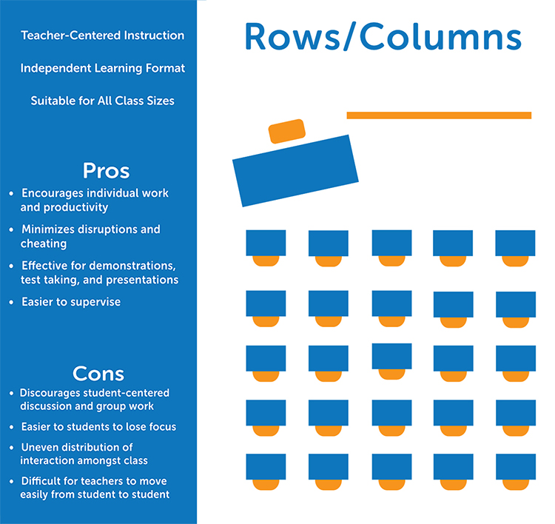

Slide 3
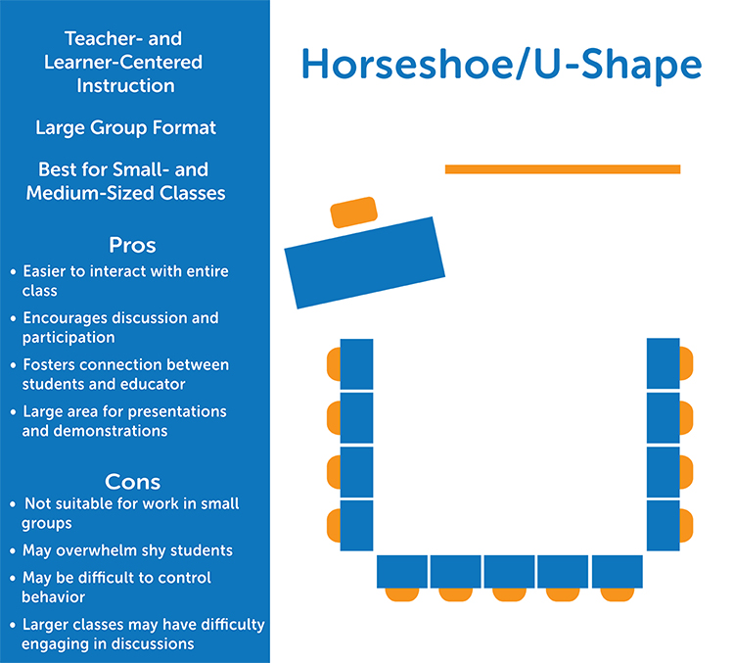

Slide 4
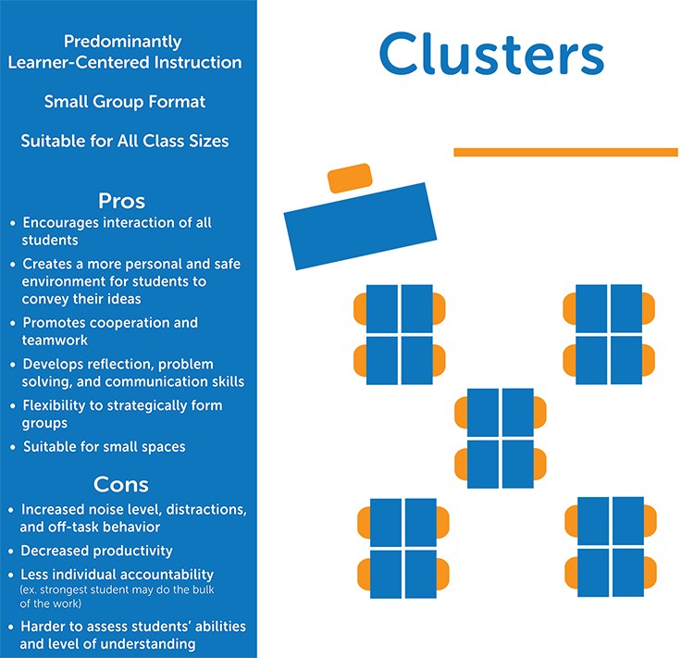

Slide 5
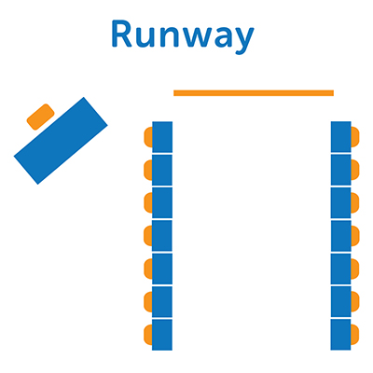
Runway
Best used with smaller classes, this setup puts the emphasis on the educator. The teacher uses the runway between the two rows of facing desks to conduct the lessons. This layout is great for discussions and lecture based classes.

Slide 6
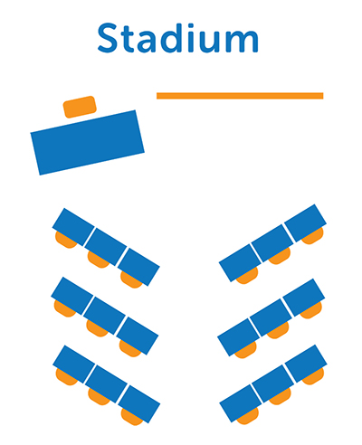
Stadium
A variation of the classic row configuration and runway, desks are grouped in clusters but all facing the same direction. Like runway, this layout is best suited teacher-centric classes

Slide 7
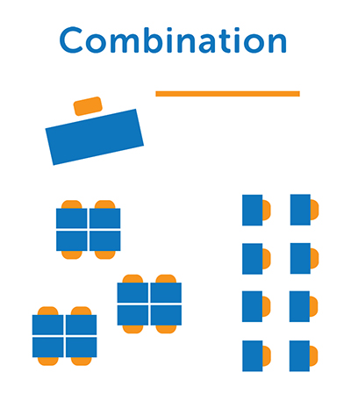
Combination
This configuration is great for classes with students of varying learning levels, methods of learning, and behavioral issues. Mix and match any configuration to best fit your needs and your students’ abilities. For example, set up part of the room as rows for students who need to focus on individual work and another part as a mini horseshoe for students who require more discussion-based activities.

